Slide 1
Antenna Modeling for Beginners
Jonathan Woo W6GX
June 27 2013

Slide 2
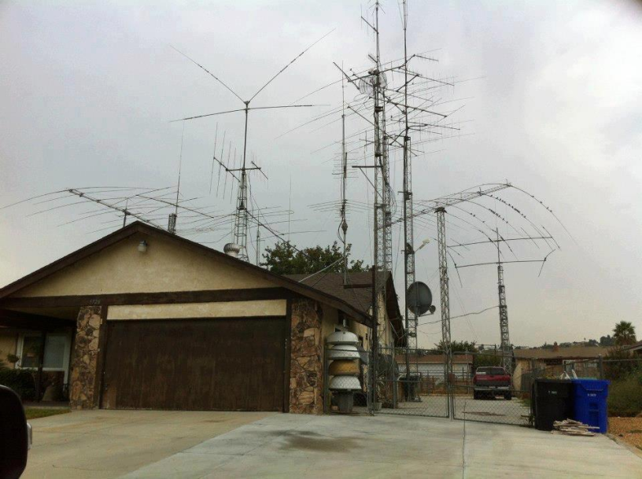
Why antenna modeling?

Slide 3
Why antenna modeling?
Which antenna would be the best choice given your QTH/XYL/budget constraints.
Antenna home-brewing.
Antenna shopping- performance comparison/validation.
Multi-band antennas- check performance by band.
Determine effects of raising or lowering an antenna.
Check interactions on multiple antenna installations.
Saves time, money, and frustration.
Notes:
Attic dipole or ground-mounted vertical is better?
Dipole to a yagi
Eham
A lot of antennas could offer compromised performance on other ‘unadvertised’ bands

Slide 4
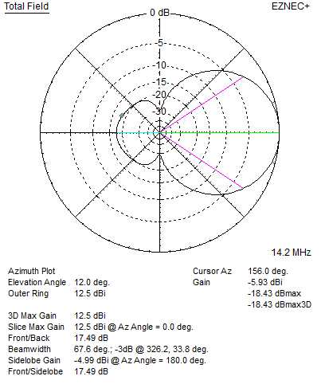
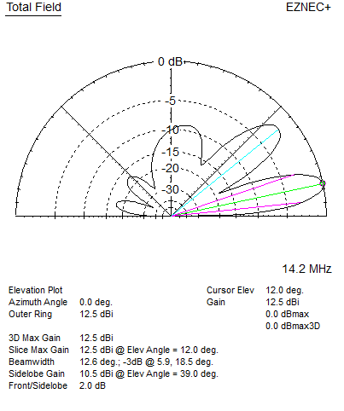
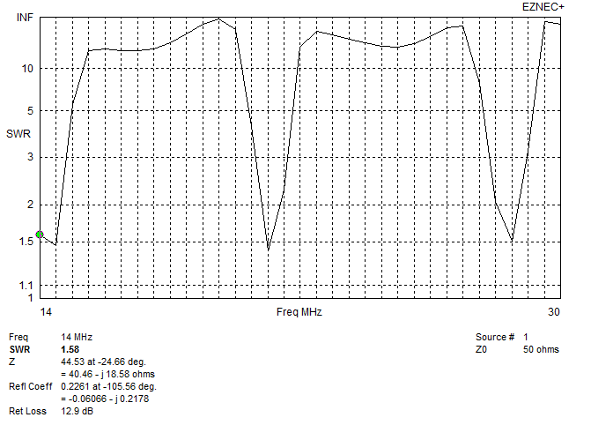
Why antenna modeling?
Brings objectivity to a very complex problem
And it’s easier than ever
Notes:
Never do one model and be done. Always comparing the results by changing some variables.

Slide 5
How To Get Started

Slide 6
NEC (neck)- a modeling engine
NEC stands for Numerical Electromagnetics Code. Dates back to the 1970’s and written in Fortran.
NEC engine hasn’t been updated. However modeling tools such as EZNEC continues to advance.
EZNEC is a modeling tool that uses the modeling engine NEC. Many other modeling tools are available, some are free-of-charge and some are not. The use of the engine NEC-2 is free (public domain).

Slide 7
EZNEC (EZ neck)- a modeling tool
Most popular antenna modeling tool (www.eznec.com)
ARRL free version- unlimited use only on ARRL data files. Comes with the ARRL antenna hand book CD.
Free trial version- unlimited use on any data file however limited to 20 wire segments.
EZNEC v. 5.0- $89; EZNEC+ v. 5.0 $139; EZNEC Pro v. 5.0 $650+
Other free modeling tools are available such as 4nec2 (http://www.qsl.net/4nec2/)

Slide 8
Antenna Modeling Basics

Slide 9
EZNEC Basics
Wires- antennas are modeled as a collection of wires, whether the actual antenna is made of wires, rods, tubing, solid surface, or towers. Anything that radiates need to be defined as a wire or collection of wires. A classic dipole could be modeled as one wire.
Segments- tells EZNEC how to divide up the wire for its calculations. Each segment has equal current and other electrical properties in the model. Affects model accuracy.
Notes:
A wire is the heart of antenna modeling. Straight, same material, same diameter, ect.
Auto segmentation. Computer advances.

Slide 10
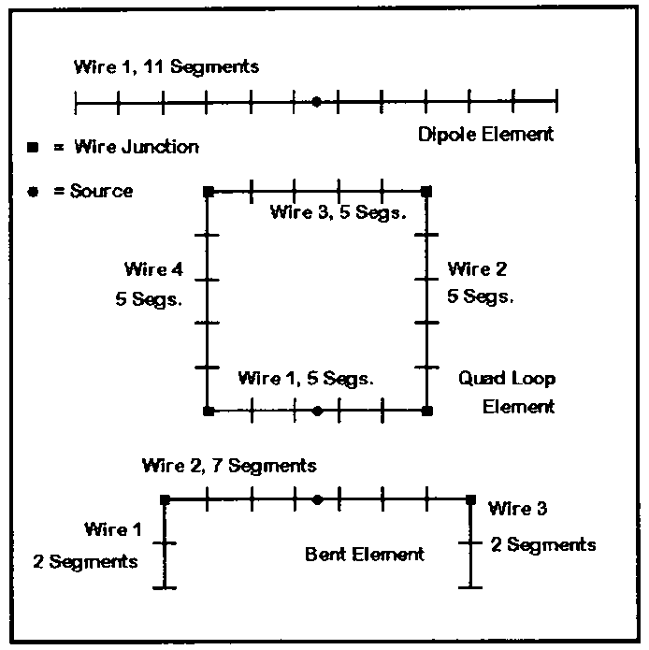
EZNEC Basics
Notes:
Inverted V, vertical with 4 ground plane radials, mobile whip antenna on a car, parabolic dish antenna.

Slide 11
EZNEC Basics
Wire loss- specify the wire resistance by selecting wire material (i.e. aluminum, copper, etc.)
Wire diameter- potential impact on modeling output. Different wire diameters necessitates modeling each wire separately.
Notes:
Classic aluminum yagi

Slide 12
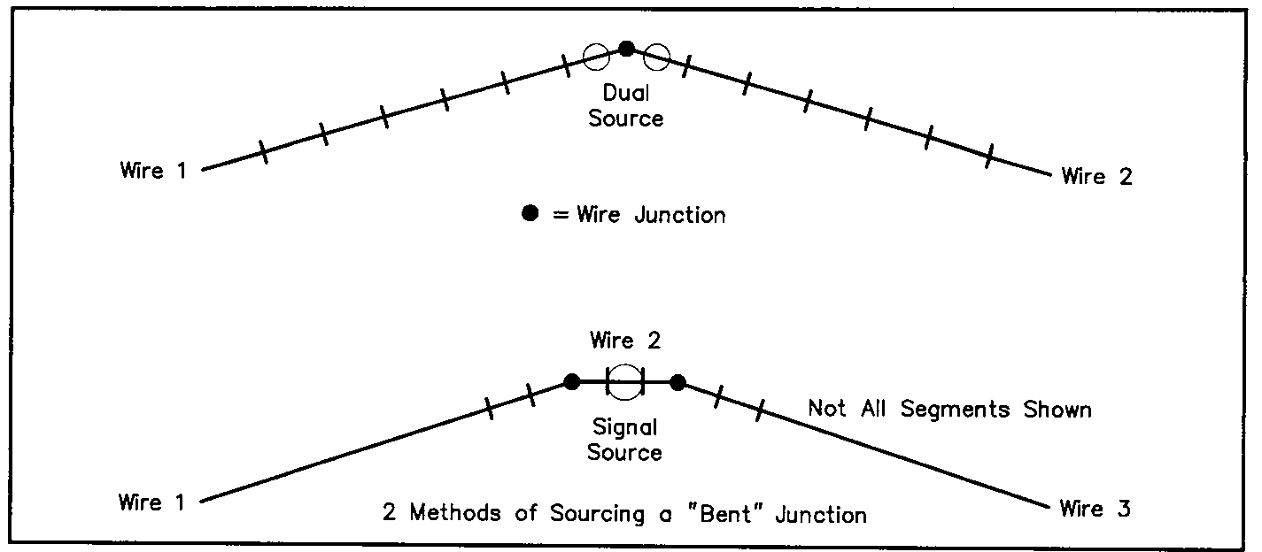
EZNEC Basics
Sources- bring voltage or current to the wire, aka as a feedpoint. Needs to be placed at the center of a segment.
Notes:
Odd # of segments

Slide 13
EZNEC Basics
Ground types- free space, perfect, or real ground
Loads- lumped impedance (i.e. loading coils, traps, etc.) Three types- R + jX, RLC, and Laplace transform polynomials.

Slide 14
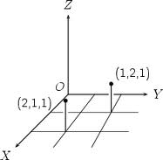
Cartesian Coordinates

Slide 15
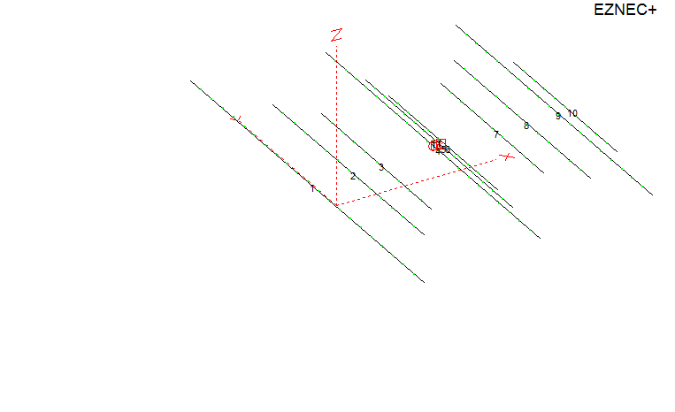
Cartesian Coordinates
Modeling convention- on directional antennas keep the firing end along the positive X-axis. Keep the reflector at X=0. The boom at Y=0. Z = height of the antenna.

Slide 16
Interpreting the Results
Currents- checking antenna’s operation and to validate the model
Source data- impedance, SWR, RMS V/I
Far field plots- 2D azimuth (aka polar plot), 2D elevation, 3D.
  Gain, beamwidth, F/R, F/S, lobes.
Antenna efficiency- calculates radiation efficiency
SWR sweep
Notes:
Check the robustness of the model before you read into the performance-related results. Are the currents symmetrical? Abrupt changes in current.

Slide 17
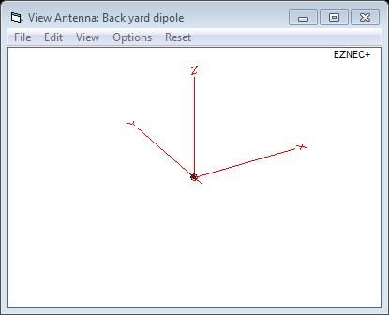
Modeling a 20m Dipole @ 30’
L (length in feet) = 468 / f (frequency in Mhz) = 468 / 14.2 = 32.96’.

Slide 18
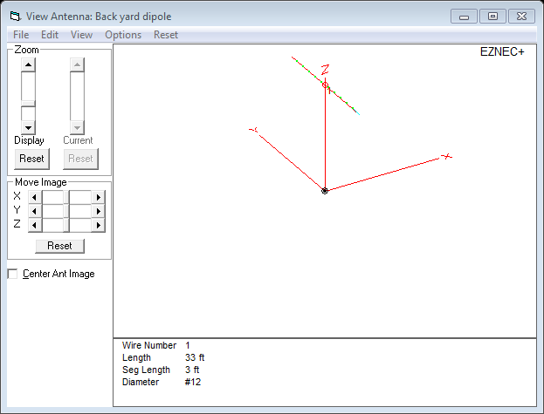
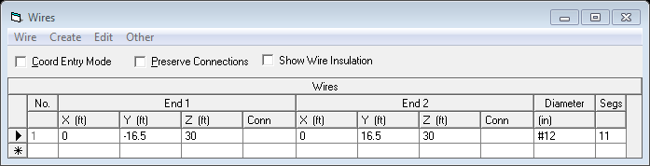
Modeling a 20m Dipole @ 30’

Slide 19
Live demo

